Slide 1
Greedy Algorithm
Course Code: CSC2211
Course Title: Algorithms
Dept. of Computer Science
Faculty of Science and Technology
Lecturer No: | 06 | Week No: | 06 | Semester: | Spring 20-21
Lecturer: | Mushfiqur Rahman; mushfiqur@aiub.edu

Slide 2
Lecture Outline
Optimization Problem
Greedy Algorithm.
Coin Changing Problem.
Fractional knapsack Problem.
Huffman Encoding.
Activity Selection Problem.

Slide 3
Activity-Selection Problem
Problem: get your money’s worth out of a festival
Buy a wristband that lets you onto any ride
Lots of rides, each starting and ending at different times
Your goal: ride as many rides as possible
Welcome to the activity selection problem

Slide 4
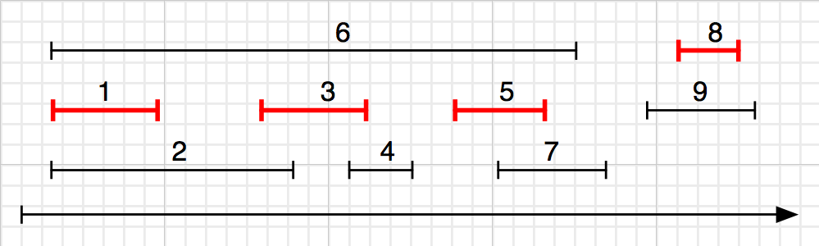
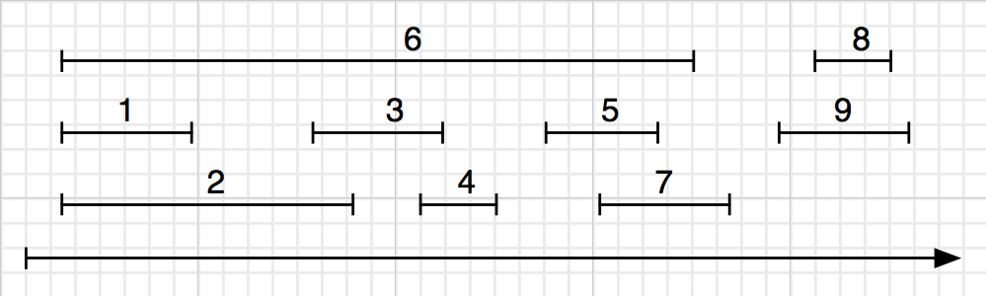
Strategy :tegy 1. Earliest First
The idea is to start with finish-first activity.
1. Sort the activities by finishing time, breaking ties arbitrarily.
2. Pick the first one.
3. Do the following for remaining activities:
If the start time of the current activity is greater or equal to the finish time of the previously selected activity, we select the current activity.
|A| =?SE 221: Algorithms
|A| = 4.
CSE 221: Algorithms
This strategy is the one that works.

Slide 5
Example
Here are a set of start and finish times
Activities | A1 | A2 | A3 | A4 | A5 | A6 | A7 | A8 | A9 | A10 | A11
S_{j} | 1 | 5 | 0 | 3 | 6 | 5 | 3 | 12 | 8 | 2 | 8
f_{j} | 4 | 7 | 6 | 5 | 10 | 9 | 9 | 16 | 12 | 14 | 11
Sorted according to finishing time
Activities | A1 | A4 | A3 | A2 | A7 | A6 | A5 | A11 | A9 | A10 | A8
S_{j} | 1 | 3 | 0 | 5 | 3 | 5 | 6 | 8 | 8 | 2 | 12
f_{j} | 4 | 5 | 6 | 7 | 9 | 9 | 10 | 11 | 12 | 14 | 16
(A1, A2, A11, A8) (an optimal solution)
Solution is not unique, consider (A4, A1, A9, A8) (another optimal solution) [But this doesn’t follow our method]

Slide 6
Exercise
Input: A list of different activities with starting and ending times.
{(5,9), (1,2), (3,4), (0,6), (5,7), (8,9)}
Use greedy algorithm to do maximum number of activities.

Slide 7
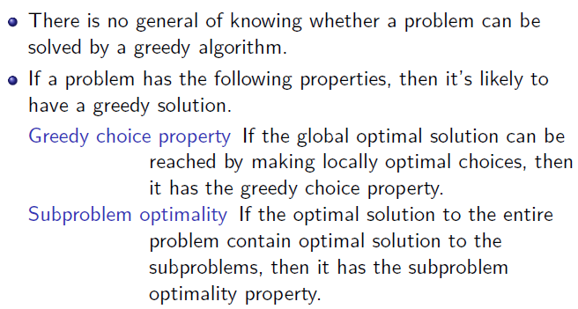
Problem types solved by greedy algorithms

Slide 8
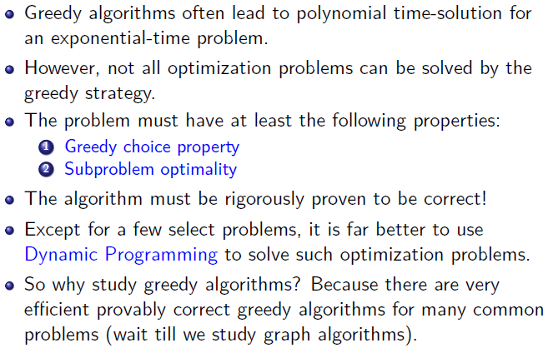
Conclusion
38 / 38

Slide 9
Books
Introduction to Algorithms, Thomas H. Cormen, Charle E. Leiserson,
Ronald L. Rivest, Clifford Stein (CLRS).
Fundamental of Computer Algorithms, Ellis Horowitz, Sartaj Sahni, Sanguthevar Rajasekaran (HSR)

Slide 10
References
https://www.tutorialspoint.com/data_structures_algorithms/greedy_algorithms.htm
https://www.geeksforgeeks.org/fractional-knapsack-problem/
https://www.geeksforgeeks.org/activity-selection-problem-greedy-algo-1/
https://www.tutorialspoint.com/Huffman-Coding-Algorithm
https://www.geeksforgeeks.org/huffman-coding-greedy-algo-3/

